Slide 1




Joint Working Group for DoD Systems Engineering Standardization
Systems Engineering Standard
Technical Reviews & Audits Standard
Presentation to NDIA SE Division
11 December 2013
Garry Roedler (WG Chair)

Slide 2
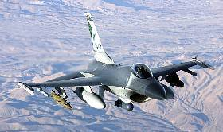
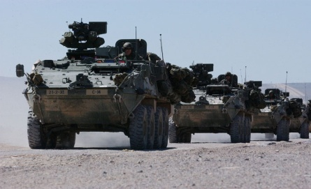
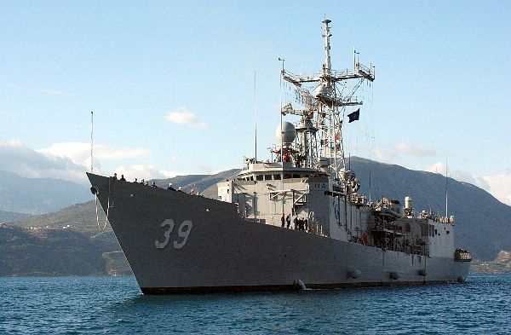
Agenda
DoD Goals and Objectives
Background – Current Situation and Approach
Current Status
Looking Forward

Slide 3
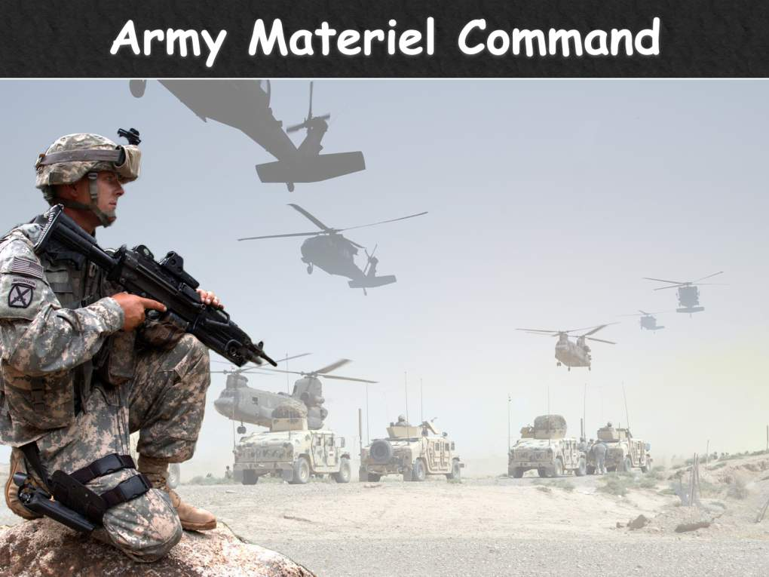
Goal of DoD Standardization Initiative
“Provide DoD and DoD contractors with a structured, uniform approach” in the areas identified as gaps
  Improve communication
  Ensure common expectations
  Add realism to bids

Slide 4
Standardization Objectives
Mutual-benefit stipulations:
  Must meet both party’s needs and objectives
  Potential teaming partners must have existing experience with subject matter of document and existing infrastructure for publishing standards
  Content of documents must be consistent with government needs
Ensure right kind of standard is developed
  Clear statement of requirements that speaks “common language”
  Specific enough to support realistic bidding and resourcing
  Proper contractual language – SHALL and should
Ensure right amount of the right standards are included
  Tailorable for different domains and contracting environments
  Consistent with DOD approach
  Conform to established, over-arching industry process standards

Slide 5
Current Situation
Each standard is intended to be put on future system contracts

Slide 6
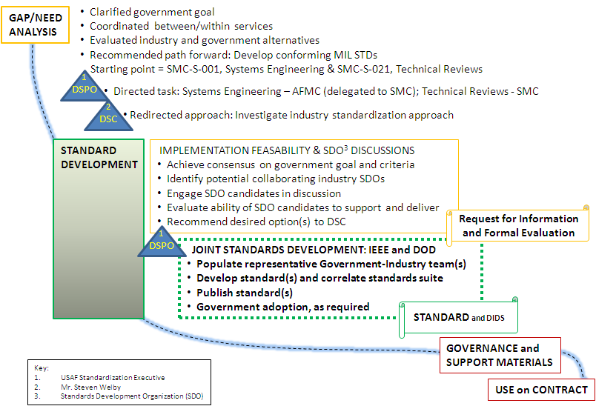
DOD SE/TRA Standards Process
Present effort

Slide 7
Membership of DoD Joint SE Working Group
Industry
Associations
Defense
Aerospace Corp
BAE Systems
Ball Aerospace
Boeing
General Dynamics
Harris Corp
L-3 Com
Leidos
Lockheed Martin
Northrop Grumman
Raytheon
SAIC
United Technologies
AIA
IEEE-CS/SA
INCOSE
ISO/IEC
NDIA
SAE Intl
Air Force (Multi-parts)
Army
Navy (Multi-parts)
OSD – DASD (SE)
DAU
DCMA
DSPO
Leadership Team
Chair, Garry Roedler, Lockheed Martin
Vice-chair, Dave Davis, USAF SMC
Secretary, Brian Shaw, The Aerospace Corp.
Technical Editor, Bill Bearden, INCOSE (SE)
Technical Editor, Mark Henley, L-3 Com (TR&A)
Membership of WG Has Broad Span
Will be adding members to cover academia

Slide 8
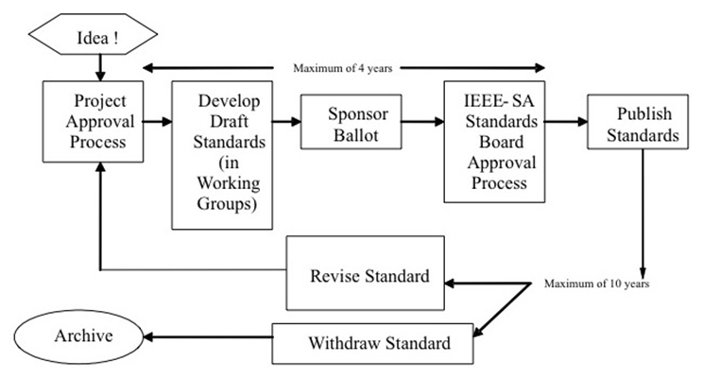
Review of IEEE Standards Process
IEEE Process Stresses Consensus

Slide 9
Reviewers Focus
Need to ensure:
  Technical accuracy
  Usability in defense environment
  Requirements are relevant and reflect good practice
  Requirements for deliverables are compatible with current methods, and do not drive a particular method/technique
  Requirements do not result in unintended consequences

Slide 10
Schedule Information
Business rhythm/cadence
TR&A and SE will have 2-week phase separation for increments
Meeting
Date +0
+7
+14
+21
+25
+28
Leadership Team Initial Review
WG Provide Inputs
Editor Consolidates Comments
Editor Prepares Draft
WG Review of Draft
Draft to WG for Review
Submit Review Comments to Editor
Review Issues from Comments at Mtg

Slide 11
IEEE Joint SE WG Schedule/Status
Integrated schedule balances efforts of both projects
    Draft development : on-going and on schedule
    Working draft: May 2014
    Publication: December 2014
Each project = 7 development increments plus reviews and balloting
15288.1 (SE) 2 increments completed; 3rd increment in review.
15288.2 (TR&A) 2 increments completed; 3rd increment about to be released.
1
2
Progress:
15288.1
1
Balloting Period
2
Draft Development
15288.2
Currently on track

Slide 12
Looking Forward
2014
  Development and publication of aligned base documents
    ISO/IEC/IEEE 15288 (DIS 1Q14; FDIS 3Q14; Publish 4Q2014)
    IEEE 15288.1 (draft 2Q14; publish 4Q2014)
    IEEE 15288.2 (draft 2Q14; publish 4Q2014)
    Also, INCOSE SE Handbook (2Q2014)
  Communicate across other working groups to ensure consistency of terms, concepts, and other information
    Liaisons established with CM and Mfg Mgt Standards WGs
    Communication across WGs to agree on resolution of identified issues
  Start preparation for adoption, governance, support, use
2015
  Adoption of standards (early 2015)
  Complete preparation for use of the standards
Alignment of SE Resources

Slide 13
Back-up Charts

Slide 14
Source Products
Source Products for SE Standard
  ISO/IEC/IEEE 15288 (CD.2), 2013
  ISO/IEC/IEEE 15289, Content of life-cycle information products (documentation), 2011
  SMC-S-001, Systems Engineering Requirements and Products, July 2013
  DoDI 5000.02
  NATO AAP-48, NATO System Life Cycle Processes, July 2012 (Addendum Standard to 15288; focused on NATO Armament Systems)
  Defense Acquisition Guide (DAG), Chapter 4, Systems Engineering, 2013
  INCOSE SE Handbook V3.2 /V4.0 Draft
  SEBoK
  EIA 632, Engineering of a System
  ISO/IEC/IEEE 24748-4
  NAVSEA Instruction & Policy 5000-009 for Systems Engineering Technical Reviews
Source Products for TR&A Standard
  ISO/IEC/IEEE 15288 (CD.2), 2013
  DoDI 5000.02
  SMC-S-021, Technical Reviews and Audits for Systems, Equipment and Computer Software, Volume 1, September 2009
  NAVSEAINST 5009.9, Naval Systems Engineering Technical Review Handbook, July 2009
  NAVAIRINST 4355.19E, Systems Engineering Technical Review Process
  NAVAIR Systems Engineering Technical Review Process Handbook, initial release
  Defense Acquisition Guidebook, Chapter 4.
Source Products include a combination of Industry and DoD resources

Slide 15
Source Products Usage
Approach for Use of Source Products
  Use as body of knowledge for defense programs
  Identify relevant information that should be considered
    Identify differences or additional tasks that need to be considered
    Identify key outputs and their attributes
    Identify essential guidance needed to provide common understanding
  Assimilate key information at level that applies to most defense programs
    State in terms of “what”, not “how”

Slide 16
Review of PARs and Technical Approach
Standard for Application of SE on Defense Programs
Summary of PAR for Systems Engineering
  Identifier of Standard – IEEE Std 15288.1
  Title: Standard for Application of Systems Engineering on Defense Programs
  Scope:
    System life cycle processes, activities, and tasks of ISO/IEC/IEEE 15288 for use on any defense system across the life cycle
  Purpose:
    This standard implements ISO/IEC/IEEE 15288 for use by United States Department of Defense (DoD) organizations and other defense agencies in acquiring systems or systems engineering support.
  Need:
    Provide the defense specific language and terminology for the standard to ensure the correct application of acquirer-supplier requirements for a defense prgm.
  Technical Approach:
    Addendum to ISO/IEC/IEEE 15288 and will:
      Not repeat processes and information in 15288
      Include defense specific language and terminology
      Include necessary tailoring or changes to existing elements
      Include any additional explanation or guidance

Slide 17
Review of PARs and Technical Approach
Standard for Application of Technical Reviews & Audits
Summary of PAR for Technical Reviews & Audits
  Identifier of Standard – IEEE Std 15288.2
  Title: Standard for Application of Technical Reviews and Audits on Defense Programs
  Scope:
    Establishes the requirements for technical reviews and audits to be performed throughout the acquisition lifecycle for the U.S. Department of Defense (DoD) and other defense agencies.
  Purpose:
    Amplify ISO/IEC/IEEE 15288 Clause 6.3.2.3.a for selection, negotiation, agreement, and performance of the necessary technical reviews and audits, while allowing tailoring flexibility for the variety of acquisition situations/ environments when the technical reviews or audits are conducted.
  Need:
    Provide the defense specific language and terminology for the standard to ensure the correct application of acquirer-supplier requirements for a defense program.
  Technical Approach:
    Standard will be in the form of a full standard that has links to ISO/IEC/IEEE 15288 and will:
      Elaborate on the activities and tasks related to TR&A
      Include defense specific language and terminology needed for the standard
      Include the criteria for reviews & audits
      Include the expected/required outcomes/ products of reviews & audits
      Include any additional explanation or guidance

